Slide 1
Introduction to Programming Using Python

Slide 2
Objectives
Programming to non-programmers
Demonstrate Operations and Methods
Enable and energize new programmers
Learning by doing
Notes:
What do you want from this course?
What do you want from programming?

Slide 3
Instructor – Ray Smith raysmith@alum.mit.edu
Years of Programming – engineering, scientific, financial
Commercial, Scientific, Systems Languages – C, C++, Perl, Java, Python, Assembly
NEW - Games for very young 3-8 years
Notes:
What would you like to know about me?

Slide 4
Telling the Computer What to Do
The language, PYTHON, is the rules
Popular, Powerful, and EASY
Like most human languages - Don’t have to know all
Notes:
What should the computer do for you?
What should the programming language (Python) do?

Slide 5
Computer = VERY Obedient Servant
Car Example
Most cars are alike
Does what you tell it – hopefully what you want
Same response every time – almost – e.g. forward / backward
Car gets the blame…
Notes:
What does a car do for you?
What does a car do that you don't really need / want?
What is the most difficult thing about using a new car?

Slide 6
Similar activities
Abstract / Indirect
Cooking recipes
Travel directions
Assembly instructions
Physical – What you see is what you get
Construction - Roads, Buildings
Notes:
What's difficult about using recipes, maps, instructions?

Slide 7
Like Computer Programming
Build once – use many times
Builder and user(s) often different
Building errors show up many times
Mistakes don't always show up immediately

Slide 8
Not so like Computer Programming
Physical materials
Hard to copy
Hard to manipulate
Easy to see

Slide 9
What's Easy – No so physical
Creation / copying / moving is a snap
Don't wear out
Change easy
Work on new, while using old

Slide 10
What's Not Easy – because No so physical
Can't "see" it
Everything connected – unexpected consequences
Not easy to tell how close to done

Slide 11
Our Sandbox – python’s IDLE
https://www.python.org
Download latest python 3.7.0
Python shell
Documentation
IDE - editor, execution, debugger
Notes:
What would you like from a programming tool / helper?

Slide 12
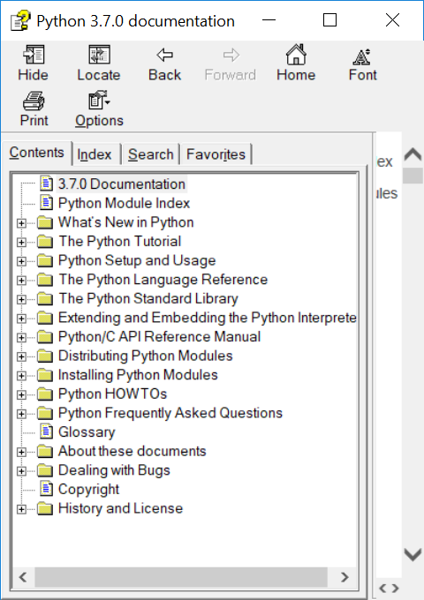
IDLE – Lots of Nice STUFF

Slide 13
Download Python
www.python.org
Instructions: pythonorg.docx
Notes:
What problems have you with a new computer?
What problems have you had in getting a new program for you computer?

Slide 14
IDLE – continued
Look around – Help ➔ Python Docs
Play with shell 2 + 2, PRESS ENTER
Notes:
What should IDLE do for you?

Slide 15
IDLE – continued
Create file File ➔ New File
… add text
File ➔ Save
Maybe in folder “classwork” ???
Reuse - File ➔ Save As…
Notes:
What is a file?
editing
location
What are the issues with a file?

Slide 16
Hello World!
Create file
File ➔ New File + File ➔ Save As…
File ➔ Recent Files + File ➔ Save As…

Slide 17
Hello World! - continued
Write simple program:
print("Hello World!")
print("My name is Ray.")
Save file – File ➔ Save
Run program – Run ➔ Run Module

Slide 18
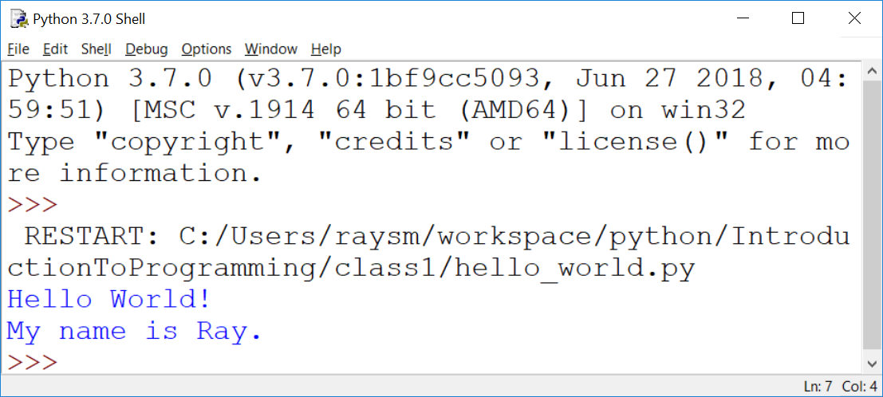
Hello World! - output

Slide 19
Python Language - Minimum
# Comment – Just say it
# "#" to the end of line
# Not executed but what is wanted
""" Doc Strings – Multiple lines """
"""
Good to start and end
on empty lines
"""
Notes:
What does the programming language do?
What should the programming language have?

Slide 20
Python Language - continued
Arithmetic almost like algebra class : +,-,*, >, >=, ==
BUT single “=” is for assignment
max_value = 20
value = value + 5
in = pr * (1+rate)**years

Slide 21
Python Language – print function
Prints one or more values
Separate values by commas (,)
print("Hello")
Print("value: ", 10)
print("Maximum: ", max)

Slide 22
Python Language - Testing
“if” condition “:”
One or more indented lines
if value > max_value:
print("value", value, " is big")
print("Try less than", max_value)

Slide 23
Python Language - Looping
“while” condition “:”
One or more statements indented
to the SAME indentation
while value < max_value:
print("value ", value, " is OK")
Value = value + 10
print("value is now", value)
Notes:
Why loops?
What should a loop have / do?

Slide 24
Exercise: “Times Tables” for 13 – 1x13, 2x13, …,13x13
Hints:
Create new file named “timestable.py”
Set, that is name and initialize variables – first(1), last(13), running(first,…,last)
Use “while”
print(n, "x", nval, "=", n * nval)

Slide 25
Python Language – input function
Just get user input
inp = input()
Prompt user first
inp = input("Please enter:")
Convert to Integer
nval = int(inp)

Slide 26
Exercise: “Times Tables” – with user giving number
Hints:
Use “timestable.py” as start
New file name = “timestableN.py”
Replace “13” with variable “nval”
Use inp = input("Enter mult:")
Use nval = int(inp)

Slide 27
Exercise for LATER: “Times Tables” – Full table from 1x1 to NxN
Hints:
timestableN.py → timestableNbyN.py
How to do it by hand?
How many loops?
What are the variables?
Notes:
What are the issues?
What's the most difficult thing to achieve.

Slide 28
A Program We Can do
I’m thinking of a number …
Simplification - Helps the user
Get guess - tell if greater, less, equal
Iteration - learn along the way
Notes:
What sort of programs are there? Could there be?
Calculators – financial, industrial
Games

Slide 29
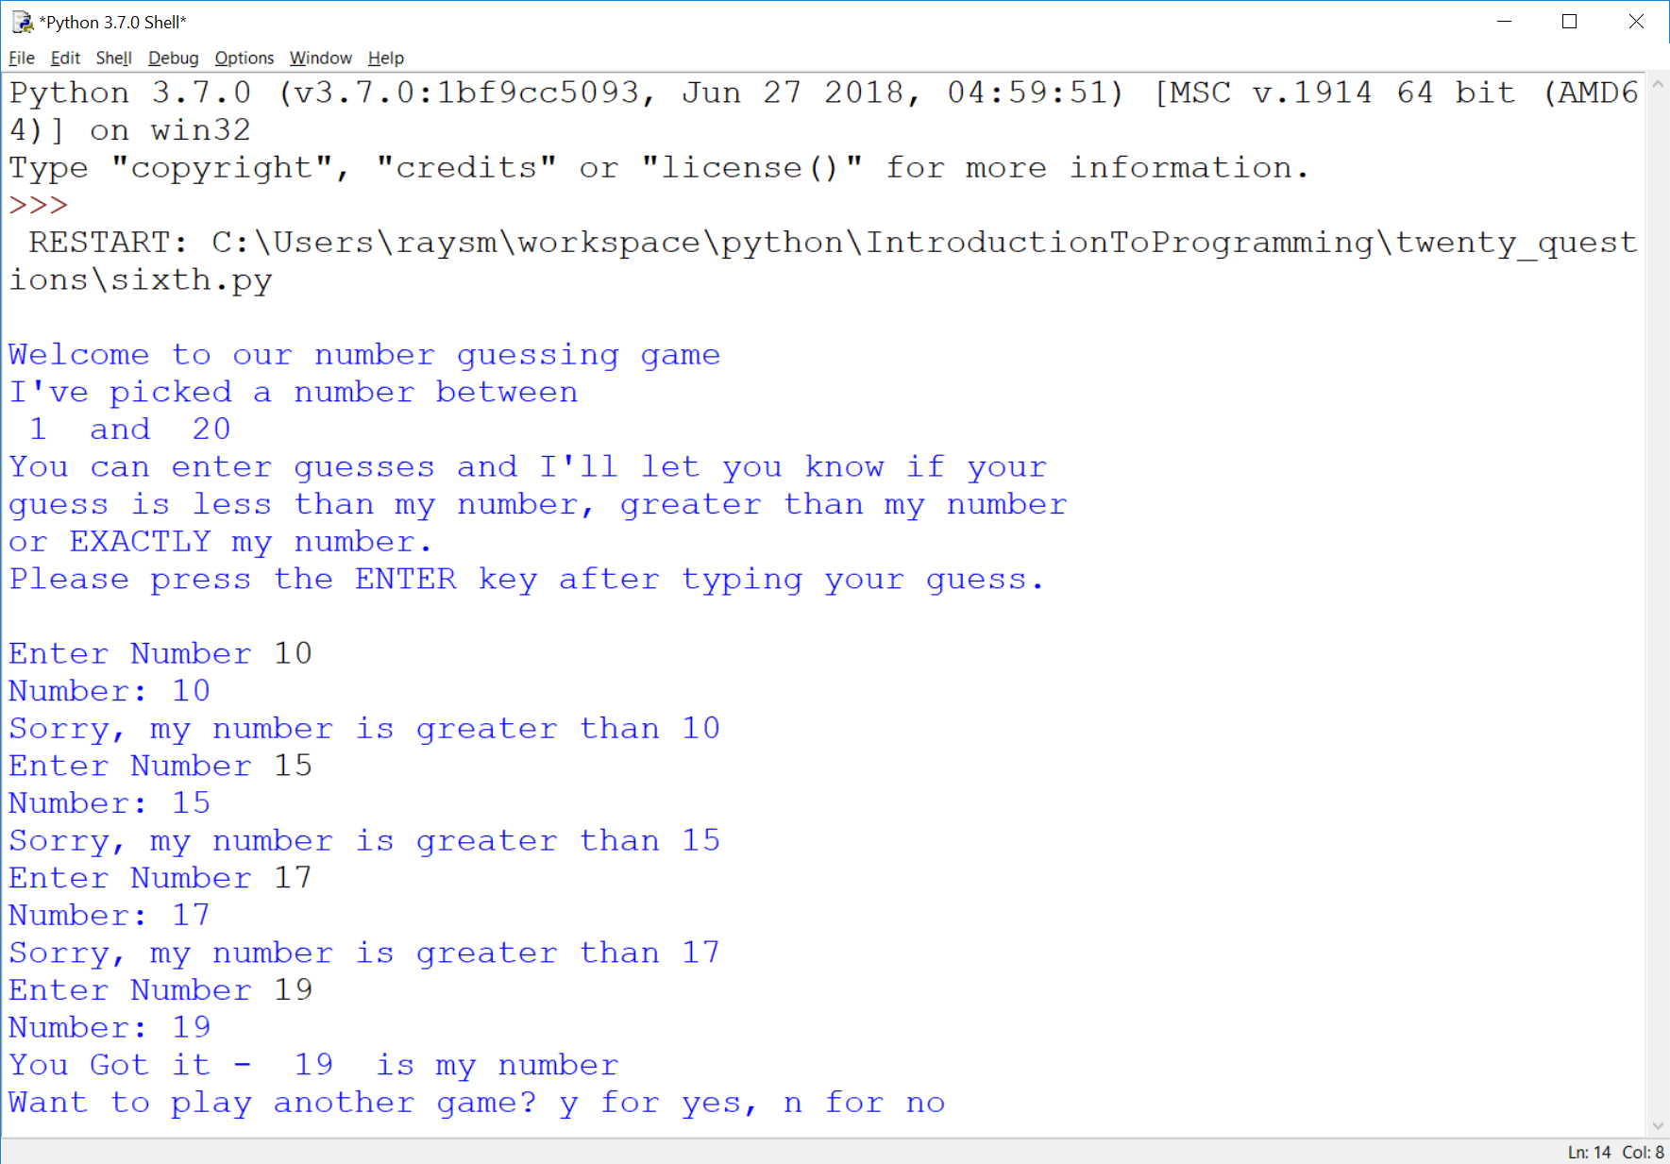
Here’s the goal
Notes:
What should we be able to do with programs?

Slide 30
Guessing Game – Iteration 1
Create new file named “first.py”
Do the smallest part
Loop, asking number
Print number entered
Notes:
What is iteration?
Why iteration?
Any problems with iteration?
What's in a game?
goals
interaction
input
output
beginning, middle, end

Slide 31
Guessing Game – Iteration 1 - continued
Hints:
Place comments describing task
Use while True:
What variables?
Use string = input("…")

Slide 32
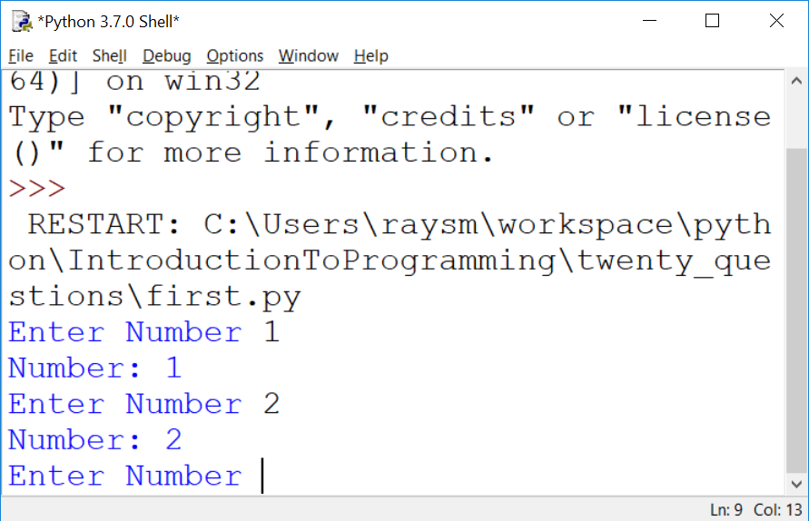
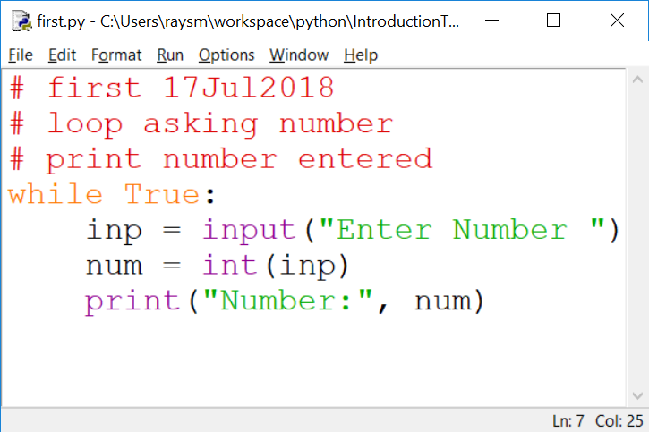
The First Iteration
Notes:
What do we get from doing this iteration?
learning
testing
early fun?
What does it cost us?

Slide 33
Second Iteration – A bit More
Set target value
Quit if number entered number equals target
Hints:
Start from first.py
Use break to quit while loop

Slide 34
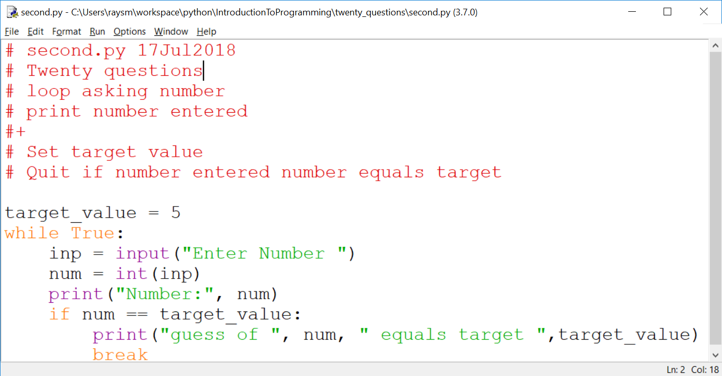
Second Iteration – continued

Slide 35
Thinking of Iterations
Think Features
Prioritize
Order most to least / easy to hard
Build to the next
Balance Big Bang with Doable
Show progress
Notes:
What is(are) the simplest idea(s)
Before anything else what does the program do?
What's the next?

Slide 36
Sample Iterations
First:
loop asking number
print number entered
Second:
Set target value
Quit if number entered number equals target

Slide 37
Think of the Iterations - continued
Third: Say if greater, less or equal
Fourth: Say goals, rules before start, including "a number between…"
Fifth: Ask user if they want another – play multiple times
Sixth: Set target to random number

Slide 38
More Python – Variables Places to store values
Eases the use/reuse our data/results
Names have rules:
Start with a letter (a-zA-Z_)
Followed by zero or more digits (0-9) or letters
OK - a, a1, my_variable, a2or3
NOT - 1, 1a, my-variable, "ray,smith"
Notes:
Why variables?
What are the issues with variables?

Slide 39
Python Language Guidelines with some exceptions
A statement is on ONE line
YES:
sum = 1 + 2
NO:
sum = 1 +
2
Parenthesized grouping may be on multiple lines
YES: sum = (1
+ 2)

Slide 40
Python Language Guidelines - continued
A group of statements:
Are executed in order
Must start at same indentation (from left)
BUT Parenthesized grouping may have any indentation within the parentheses

Slide 41
Python Language Guidelines - continued
YES:
start = 1
last = 3
increment = 1
NO:
start = 1
last = 3
increment = 1

Slide 42
Exercises - Iterations - continued
Do Iterations third, fourth
Third: Say if guess greater, less or equal
Fourth: Say goals, rules before start
Simple iterations are practice
Notes:
Use the previous iteration as a start to the next.
I'll go around and watch.
Raise had if a question.

Slide 43
Functions – Divide and Conquer
Hide the particulars
Delay consideration
Parts of the problem placed in functions

Slide 44
Functions – continued
Called (invoked/started) with name(comma-separated list of parameter values)

Slide 45
Functions – continued
Function Definition – what it is going to do
Name – same style/restrictions as variable name
Parameters – data which is passed to the function
Comma-separated list

Slide 46
Functions – continued
Body – what the actions are
Regular code
Uses data passed in parameters by parameter names

Slide 47
Functions – continued
def add2(value1, value2):
sum = value1 + value2
return sum
sum1 = add2(1,2) # sum1 gets 1+2
sum2 = add2(3,4) # sum2 gets 3+4
Notes:
Function Calling / Invocation
How do we call the function?
Called with the function name
Including parenthesized list of values
The values are passed to the function

Slide 48
Functions – continued Exercise – Special Product
Write a function product(factor1, factor2, factor3)
Returns the product of the values factor1, factor2, factor3.
Test it on the following:
.5, .4, .3; 1, 2, 3; -1, -1, -1;
Notes:
Function Calling / Invocation
How do we call the function?
Called with the function name
Including parenthesized list of values
The values are passed to the function

Slide 49
Functions – Keyword parameters
Optional – for seldom used
Any Order – avoids ordering confusion
Names help understanding
myfun(key1=2, key2=7)
myfun(key1=4) # use default for key2
myfun() # All defaulting

Slide 50
Functions – Keyword parameters - continued
def myfun(key1=None, key2=7)
if key1 is None:
key1 = 5 # key1 not present
Return key1 + key2
Notes:
What are the benefits of using None vs explicit value?

